Slide 1
MOTION DETECTION AND TRACKING

Slide 2
INTRODUCTION
Detection and recognition of an object is of crucial importance especially in unmanned surveillance systems.
It has become a necessary area of research in military and security applications visual surveillance In order to identify important events in real-time in an avid manner, an intelligent visual surveillance system is proposed to assist the human operators.
This model allows us to detect and monitor human motions and movements.

Slide 3
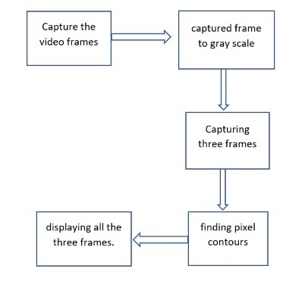
BLOCK DIAGRAM

Slide 4
WORKING
Capture the video frames using webcam
Converting the captured frame to gray-scale and remove noise
Capturing gray frame, Delta Frame and a Threshold frame.
Dilating the Threshold Frame and finding pixel contours in it.
Finding the contour area and displaying all the three frames.

Slide 5
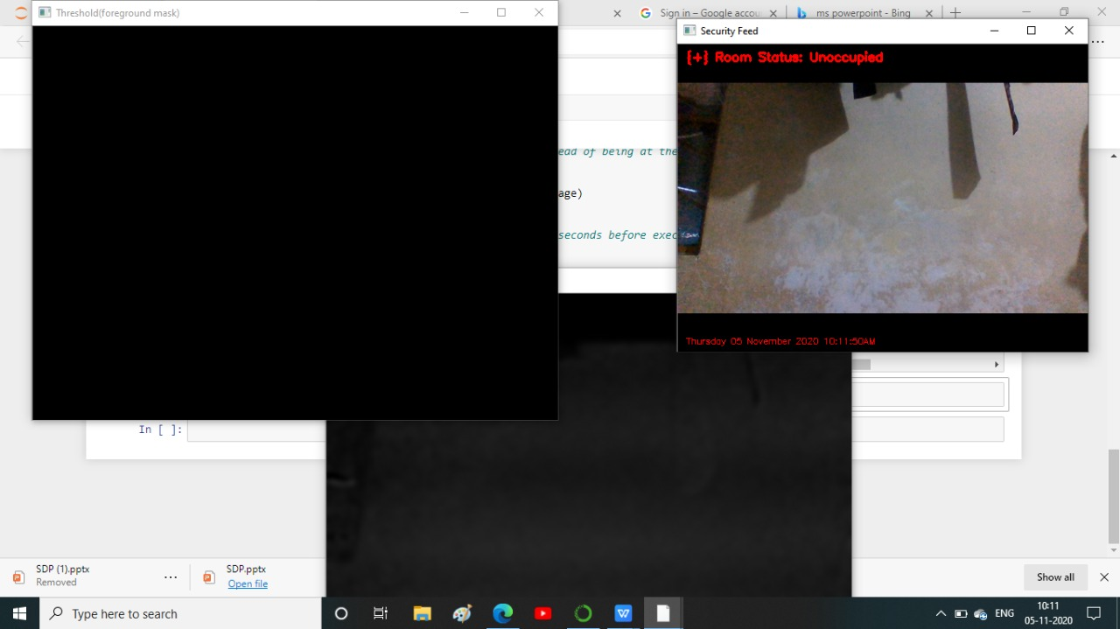
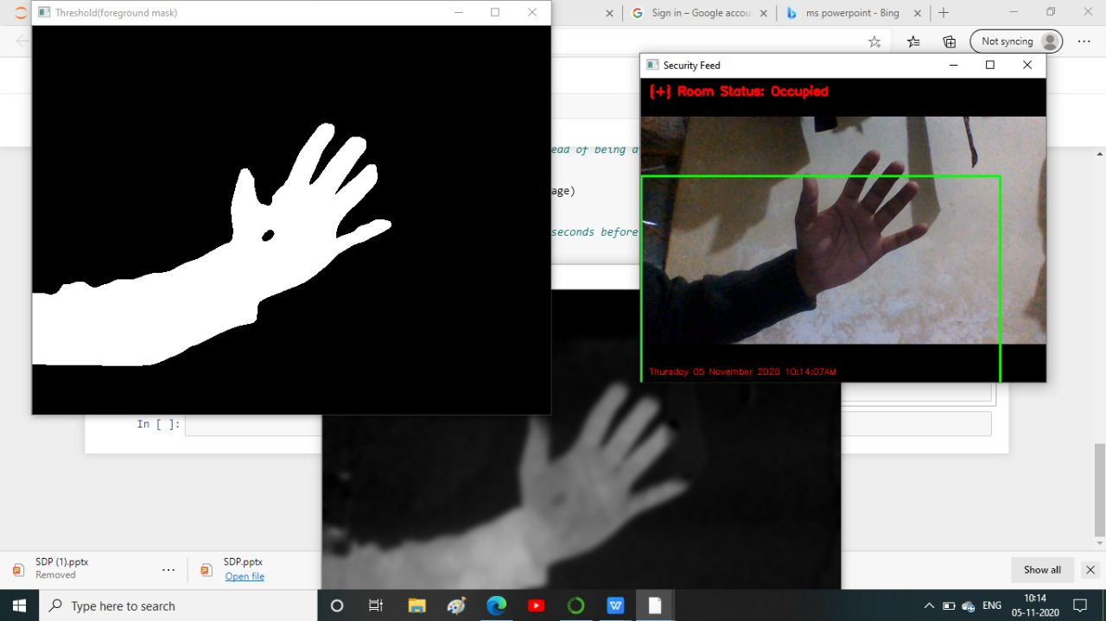
OUTPUT

Slide 6
APPLICATIONS
Detect and monitor the human movement and motions.
Video surveillance in anamoly detection.
In borders, where any motion changes should be noticed.

Slide 7
THANK YOU

